Slide 1



Data Spark
By Tech Triumphs

Slide 2
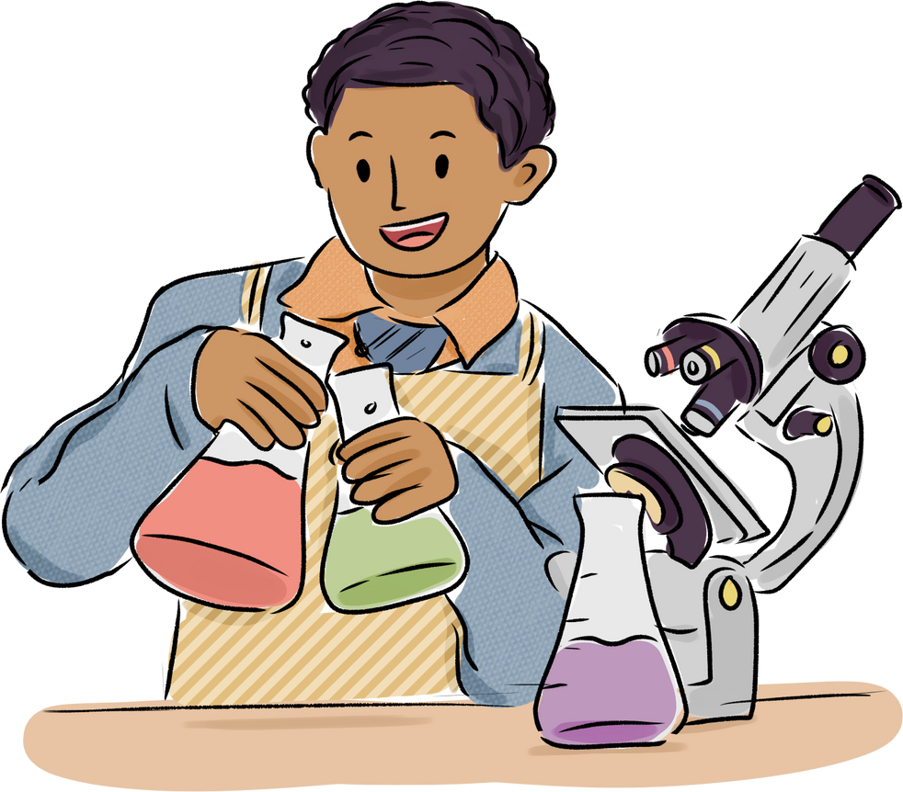
I am
Bhaumik Yadav
Inspiring fresh minds to harness data, decode patterns, and shape meaningful narratives through analytics and research.

Slide 3
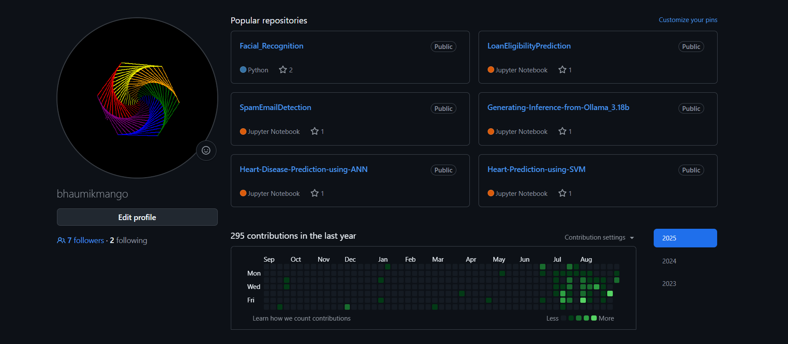
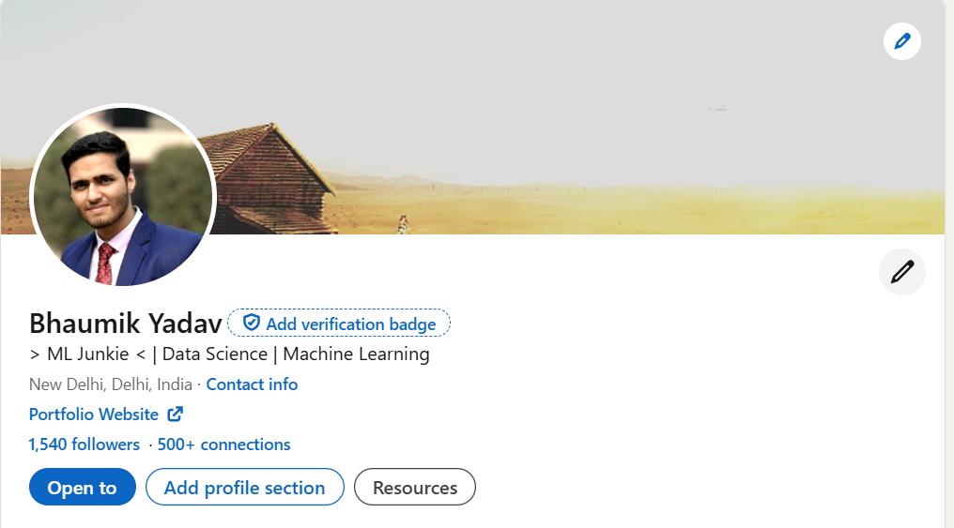
More About Me
Ex DRDO
Student Coordinator – TT
Tech Community CS & Allied
President – DataVerse Data Science Community
CS & Allied

Slide 4

AGENDA
Introduction to DS
Getting started with Data
Data Exploration and Visualization
ML Demo
Q/A

Slide 5


Join the WhatsApp group for all updates:

Slide 6
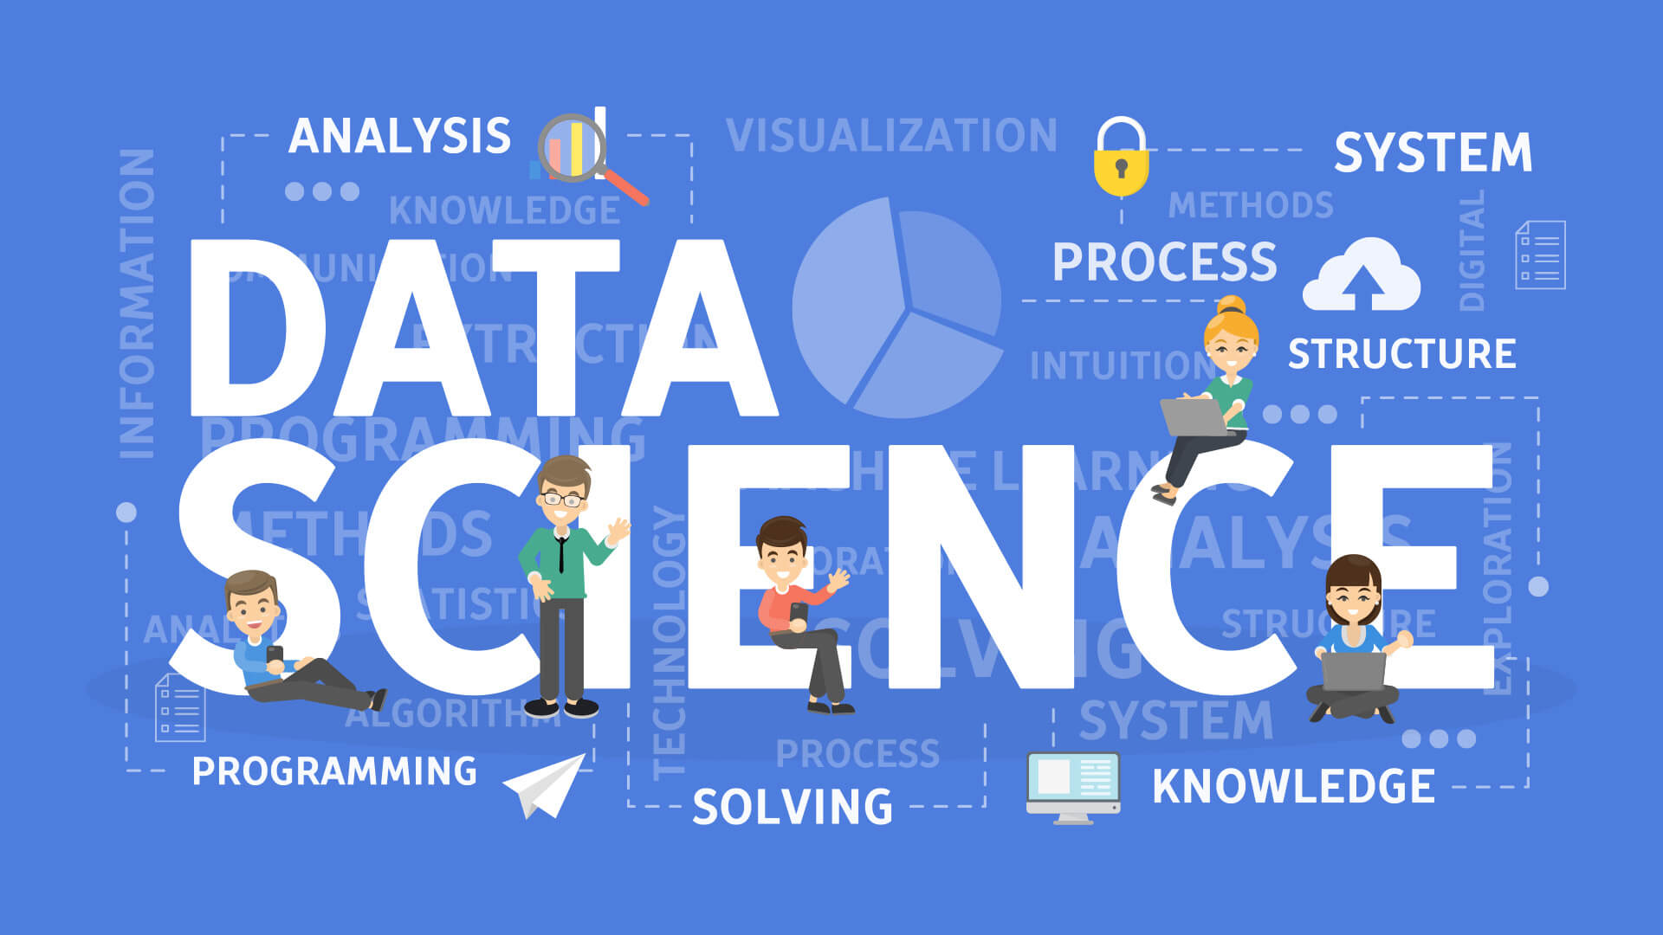
What’s Data Science?
It is the field of turning raw data into useful insights. Statistics, programming, and domain knowledge to make sense of information.
But is DS the same as coding?
Not exactly. Coding is one part of it, but DS also involves - Understanding the problem, Collecting-cleaning the appropriate data, Analyzing patterns, And sometimes even building ML/Data models, Finally explaining results in a meaningful way
Where is Data Science used in real life?
Everywhere from Netflix recommending you movies to Banks detecting fraud, Flipkart suggesting products to IPL predicting run rate

Slide 7
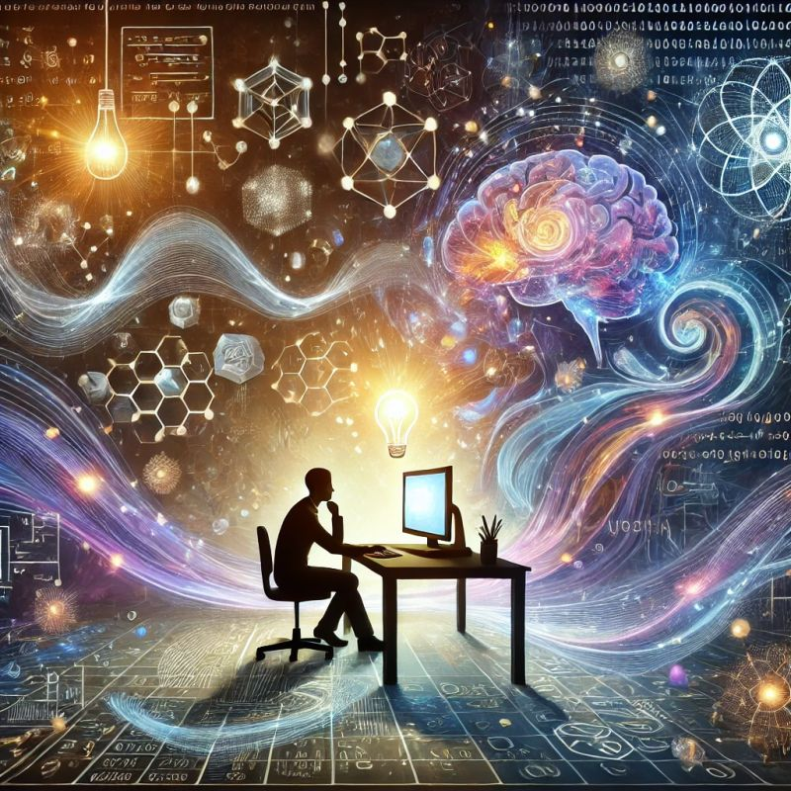
Math Math Math……….
Do I need strong math for Data Science?
For Absolute Beginners:
You can start with zero advanced math. Tools like Python libraries (pandas, scikit-learn, matplotlib) handle most heavy lifting. At the start, focus on: Understanding data; Cleaning datasets; Making visualizations; Running simple ML models (regression, classification)
As You Progress in Data Science:
Math helps you understand what’s happening under the hood. This gives you: Better model selection; More confidence in debugging results; Ability to explain insights to others. The main areas: Statistics (mean, variance, distributions, hypothesis testing), Linear Algebra (vectors, matrices → how data is represented), Calculus (optimization, gradients in ML training), Discrete Math / Logic (for algorithms & data structures)

Slide 8
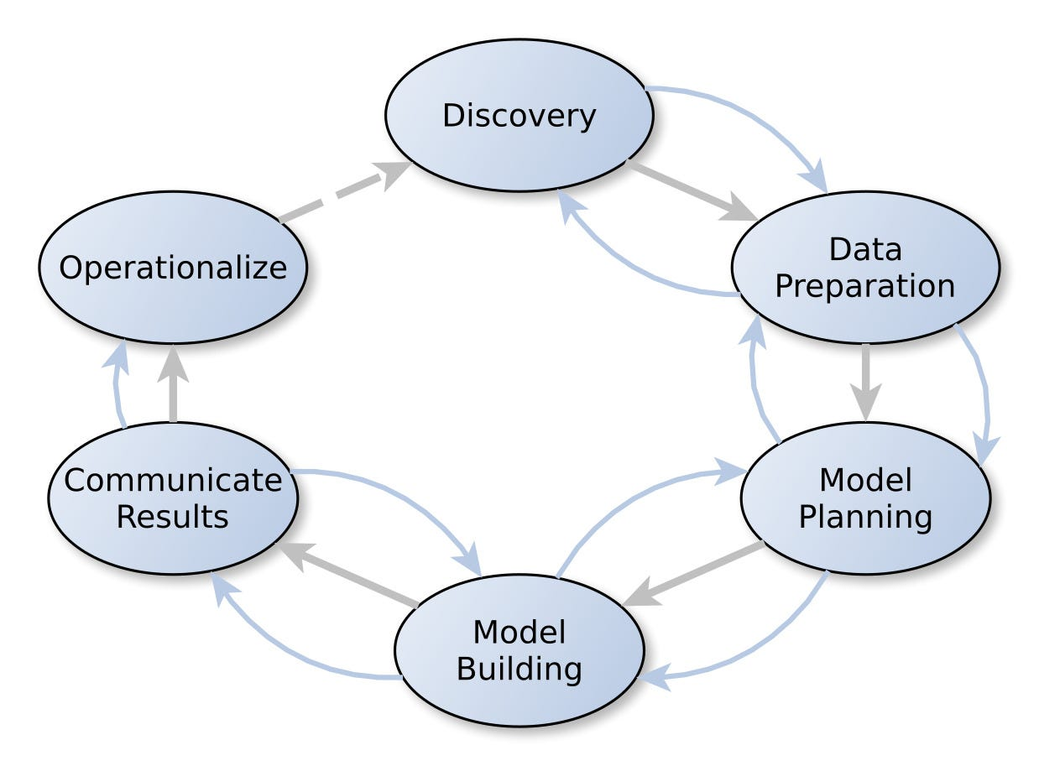
DS/DALC
This is the framework / process data scientists follow. It keeps the work structured, repeatable, and clear.
Step 1: Discovery
Define the problem to solve. Ask: “What business or real-world question do we want to answer with data?” Example: Can we predict which students are likely to drop out?
Step 2: Data Preparation
Collect, clean, and organize the data. Handle missing values, remove duplicates, fix errors. Example: Collect students’ attendance, grades, participation.
Step 3: Model Planning
Decide which methods/algorithms to use. Visualization, statistics, or machine learning? Example: Linear regression for scores vs study hours, or decision tree for pass/fail prediction.

Slide 9
DS/DALC
Step 4: Model Building
Apply the chosen algorithms to the prepared data. Train the model, test it, adjust parameters. Example: Train a classifier on Titanic dataset to predict survival.
Step 5: Communicate Results
Share findings with visuals, dashboards, or reports. Example: Instead of just giving numbers, show a chart of “study hours vs marks.”
Step 6: Operationalize
Deploy the solution in the real world.
Example: A school dashboard that automatically flags students at risk of failing.

Slide 10
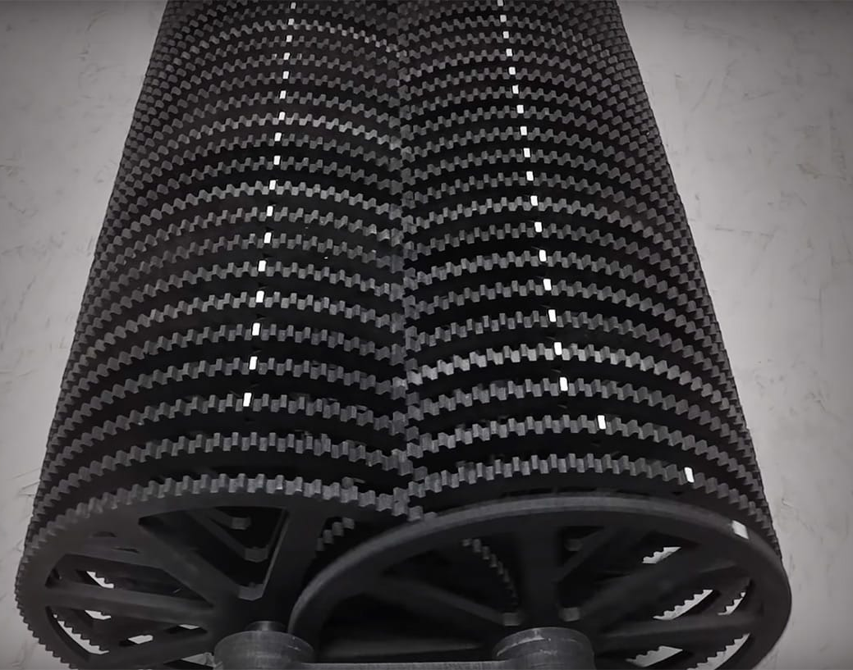
BRAIN TEASER
The figure in the left consists of 100 gears, each gear is coupled to the other one with a ratio of 1:10. How much time will it take for the last gear to rotate a full 360°
if the first gear takes 2 seconds to rotate fully?

Slide 11
Getting Started with Data
Pre-requisites:
Python (Preferably 3.10 or less)
Jupyter Notebook or Google Colab
Pandas
Matplotlib
Basic understanding of math

Slide 12
Data Exploration and Visualization
Pre-requisites:
Python (Preferably 3.10 or less)
Jupyter Notebook or Google Colab
Pandas
Matplotlib
Numpy
Seaborn
Basic understanding of math

Slide 13
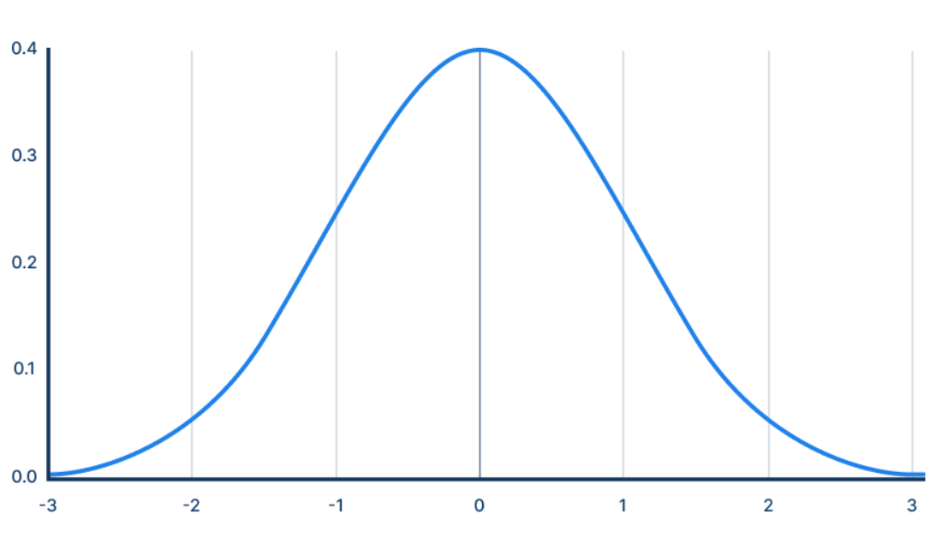
BRAIN TEASER
What is randomness?

Slide 14
Introduction to ML
Pre-requisites:
Python (Preferably 3.10 or less)
Jupyter Notebook or Google Colab
Pandas
Matplotlib
Numpy
Seaborn
SKLearn
Basic understanding of math

Slide 15

Your Focus Areas
Mathematics (Stats*)
Critical Thinking
Logical Aptitude
Analytics
Communication
Machine Learning

Slide 16


If I was good today
Link with me on LinkedIn :

Slide 17


CONTACT DETAILS
Instagram
DataVerse :

Slide 18

THANK YOU!
Eagerly waiting for new data junkies to join us!

